Slide 1
Process Selection and Facility Layout

Slide 2
Introduction
Process selection
Deciding on the way production of goods or services will be organized
Major implications
Capacity planning
Layout of facilities
Equipment
Design of work systems

Slide 3
Process Selection
Variety
How much
Flexibility
What degree
Volume
Expected output
Batch
Job Shop
Repetitive
Continuous

Slide 4
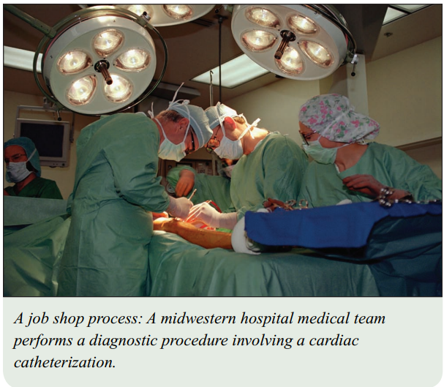
Process Types
Job shop
Small scale
Low volume of high variety goods or services
Skilled workers and general purpose equipment with high flexibility
Eg-Doctor

Slide 5
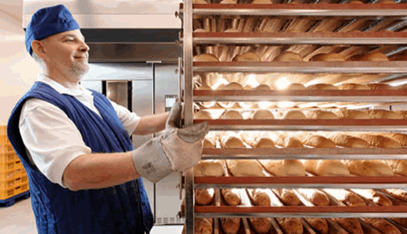
Batch
Moderate volume
Eg- bakeries which make breads, cakes or cookies in batches

Slide 6
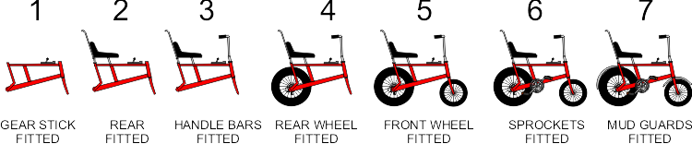
Repetitive/assembly line
High volumes of standardized goods or services
Slight flexibility of equipment is needed.
Low skilled workers
Eg- automobies, TV sets, automatic carwash.

Slide 7
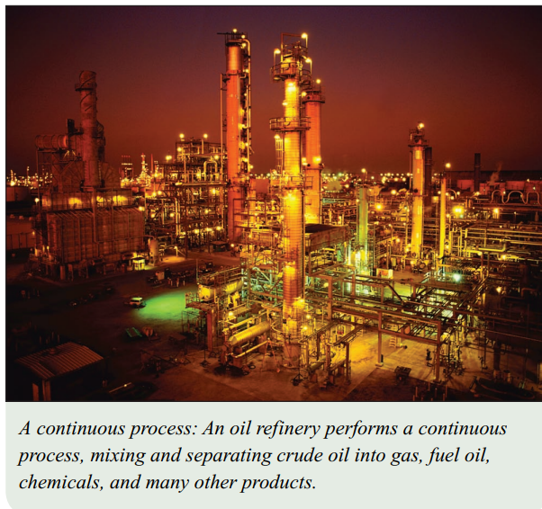
Continuous
Very high volumes of non-discrete, highly standardized goods
No variety in goods and no flexibility in the equipment
Eg- sugar, flour, salt

Slide 8
Product – Process Matrix
Dimension | Job | Batch | Repetitive | Continuous
Job variety | Very High | Moderate | Low | Very low
Process flexibility | Very High | Moderate | Low | Very low
Unit cost | Very High | Moderate | Low | Very low
Volume of output | Very low | Low | High | Very High

Slide 9
Product and Service Processes
Process Type
Job Shop | Appliance repair Emergency room |  |  | Ineffective
Batch |  | Commercial baking Classroom Lecture
Repetitive |  |  | Automotive assembly Automatic carwash
Continuous (flow) | Ineffective |  |  | Steel Production Water purification

Slide 10
Product and Process Profiling
Process selection can involve substantial investment in
Equipment
Layout of facilities
Product profiling: Linking key product or service requirements to process capabilities
Key dimensions
Range of products or services that will be processed
Expected order sizes
Expected frequency of schedule changes

Slide 11
Facilities Layout
Layout: the configuration of departments, work centers, and equipment, with particular emphasis on movement of work (customers or materials) through the system
Product layouts
Process layouts
Fixed-Position layout
Combination layouts

Slide 12
Importance of Layout Decisions
Require substantial investment of money and effort
Involve long term commitments
Significant effect on cost and efficiency of operations

Slide 13
Objective of Layout Design
Facilitate attainment of product or service quality
Use workers and space efficiently
Avoid accidents
Minimize unnecessary material handling costs
Eliminate unnecessary movement of workers or materials
Minimize production time or customer service time
Design for safety

Slide 14
The Need for Layout Decisions
Inefficient operations
Changes in the design
of products or services
For Example:
High Cost
Accidents
The introduction of new products or services
Safety hazards

Slide 15
The Need for Layout Design (Cont’d)
Changes in
environmental
or other legal
requirements
Changes in volume of
output or mix of
products
Morale problems
Eg-lack of face to face contact
Changes in methods
and equipment

Slide 16
Basic Layout Types
Product layouts
Process layouts
Fixed-Position layout
Combination layouts

Slide 17
Basic Layout Types
Product layout
Layout that uses standardized processing operations to achieve smooth, rapid, high-volume flow
Process layout
Layout that can handle varied processing requirements
Fixed Position layout
Layout in which the product or project remains stationary, and workers, materials, and equipment are moved as needed

Slide 18
Product Layout
Raw materials
or customer
Station
1
Station
2
Station
3
Station
4
Finished item
Material
and/or labor
Material
and/or labor
Material
and/or labor
Material
and/or labor
Used for Repetitive or Continuous Processing

Slide 19
A U-Shaped Production Line
Figure 6.6
In
1
2
3
4
5
Workers
6
Out
10
9
8
7

Slide 20
Process Layout
Figure 6.7
Process Layout
(functional)
Dept. A
Dept. C
Dept. E
Dept. B
Dept. D
Dept. F
Used for Intermittent processing
Job Shop or Batch Processes

Slide 21
Process Layout
Milling
Assembly & Test
Grinding
Drilling
Plating
Process Layout - work travels to dedicated process centers

Slide 22
Product Layout
Figure 6.7 (cont’d)
Product Layout
(sequential)
Work
Station 1
Work
Station 2
Work
Station 3
Used for Repetitive Processing
Repetitive or Continuous Processes

Slide 23
Fixed Position Layouts
Fixed Position Layout: Layout in which the product or project remains stationary, and workers, materials, and equipment are moved as needed.
Nature of the product dictates this type of layout
Weight
Size
Bulk
Large construction projects,aircrafts and rockets

Slide 24
Design Product Layouts: Line Balancing
Line Balancing is the process of assigning
tasks to workstations in such a way that the workstations have approximately equal time requirements.

Slide 25
Cycle Time
Cycle time is the maximum time
allowed at each workstation to
complete its set of tasks on a unit.

Slide 26
Determine Maximum Output

Slide 27
Determine the Minimum Number of Workstations Required

Slide 28
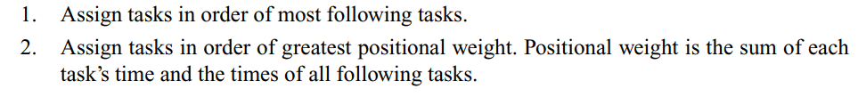
Two Heuristic Rules

Slide 29
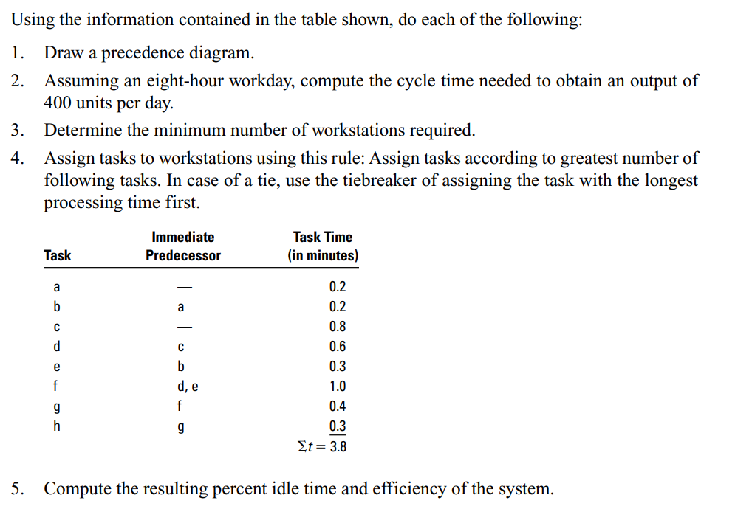

Slide 30
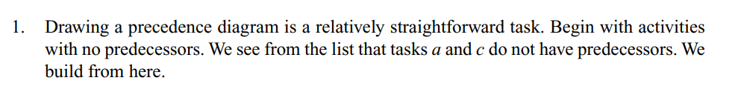
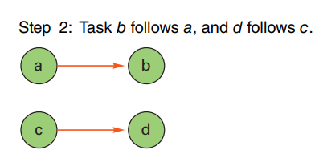
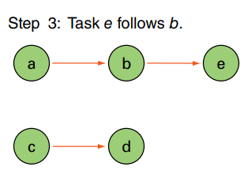
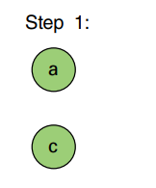
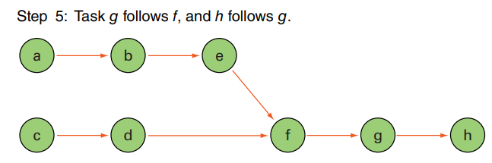
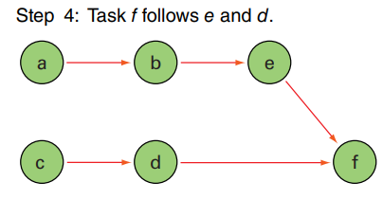

Slide 31





Slide 32
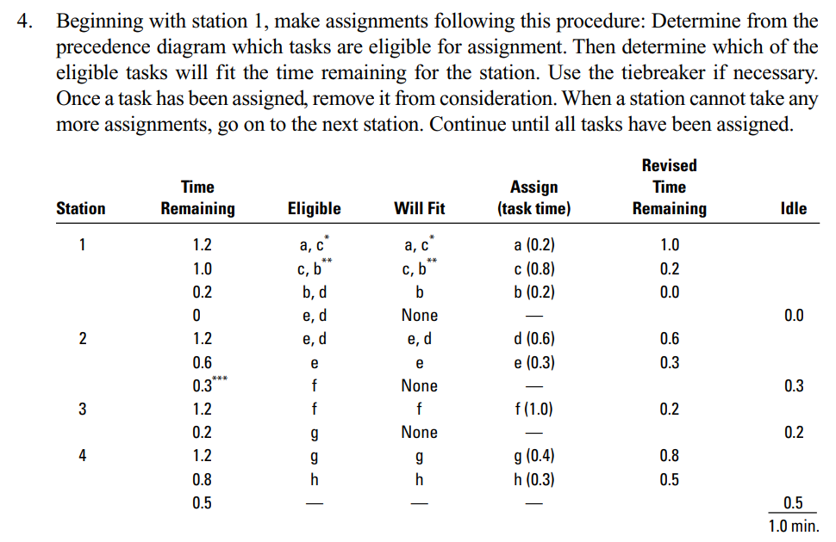

Slide 33
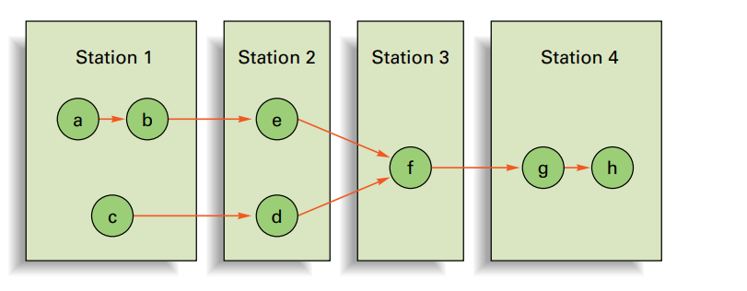
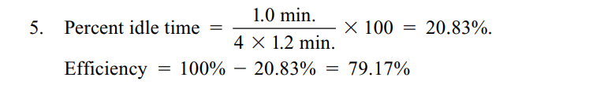

Slide 34
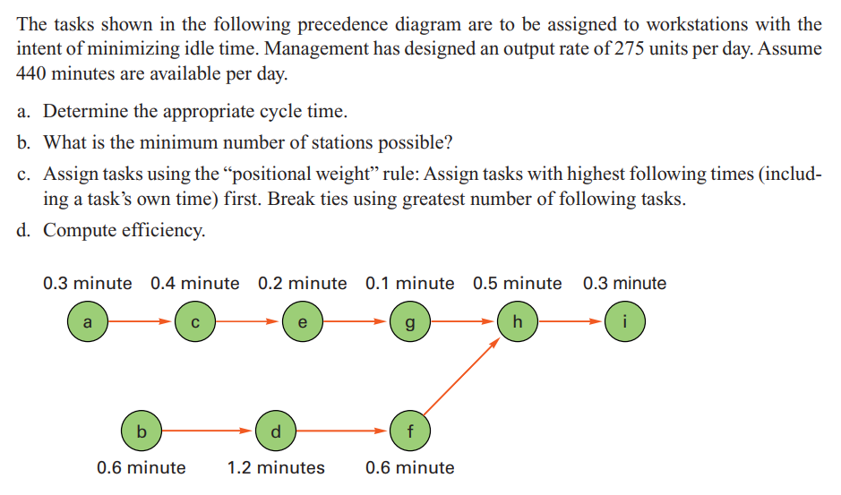
Example-Positional Weight

Slide 35
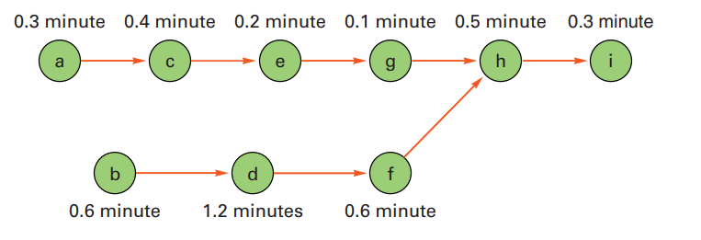
Calculating Positional Weight

Slide 36
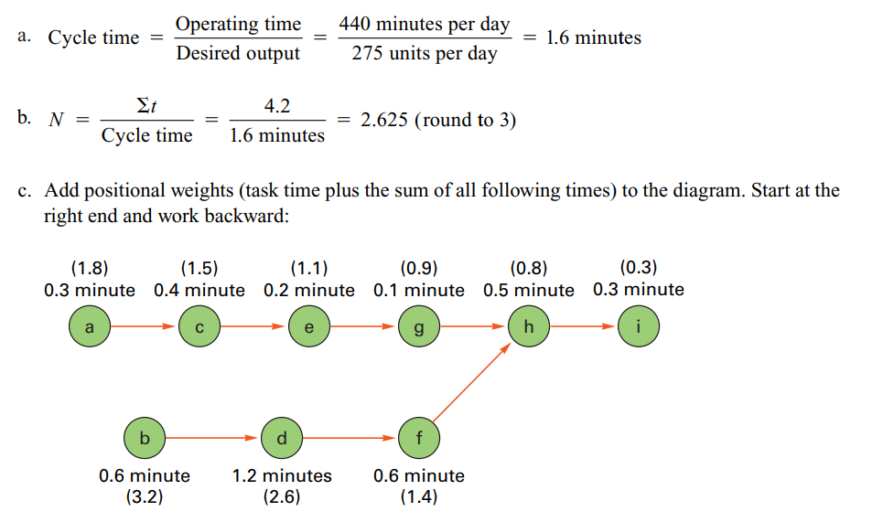

Slide 37
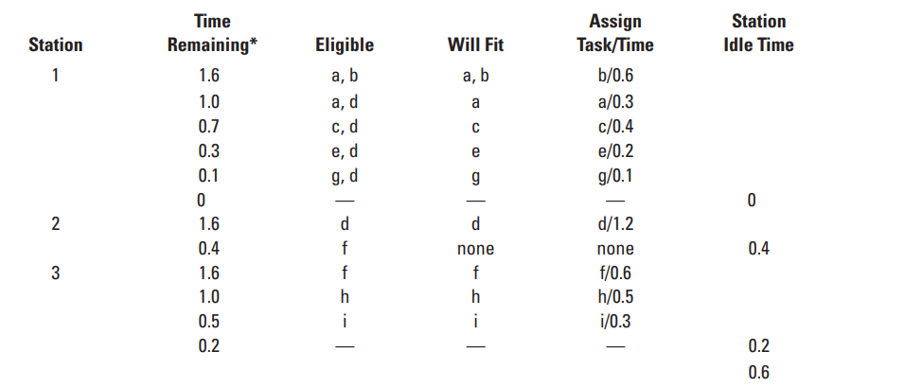

Slide 38
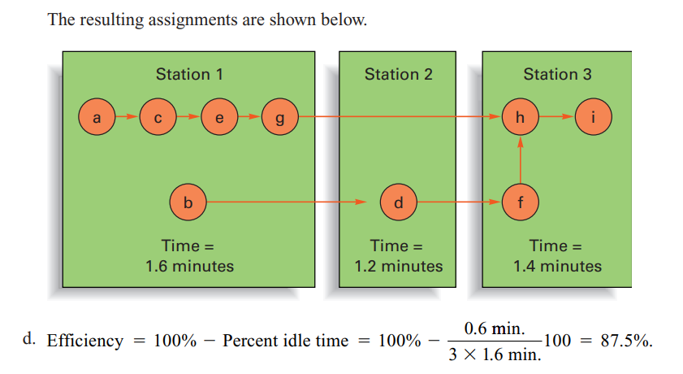
Final Solution

